Slide 1

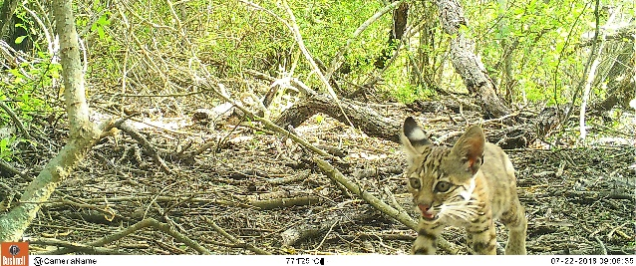
Using Python to Conduct Emerging Hot Spot Analysis on Wildlife Road Mortalities in South Texas
Tom Yamashita
MARS5470: Introduction to Scientific Programming

Slide 2
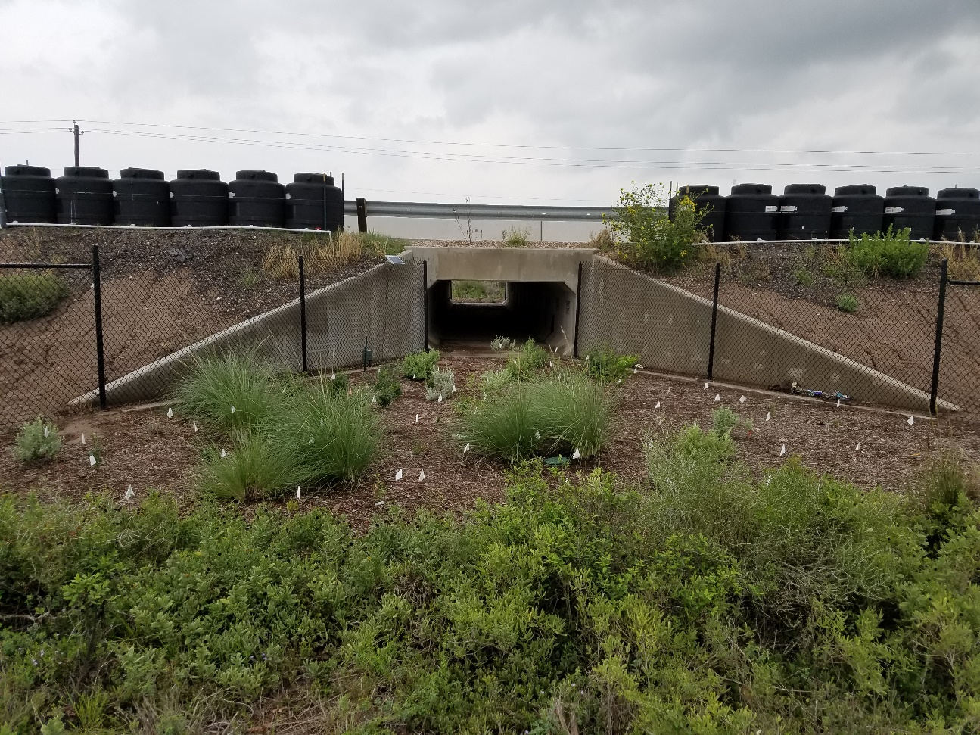

Background
Ocelots are critically endangered in the United States
A significant source of known mortalities is vehicle collisions
Several ocelot-vehicle collisions on State Highway 100
TxDOT builds mitigation structures on SH100
Surveys of Wildlife Road Mortality before, during, and after construction
Credit: USFWS
Notes:
Part of a long term monitoring project of wildlife road mitigation structures on State Highway 100
Project came about because ocelots are critically endangered and vehicle collisions are a significant cause of death
Several have occurred on SH100 leading to the construction of exclusionary fencing, wildlife crossings, and wildlife guards between September 2016 and May 2018
Conducted mortality surveys before, during, and after construction

Slide 3


Mortality Hot Spots
Intersections create gaps in fence
Potential mortality hot spots here
Emerging Hot Spot Analysis in ArcGIS
NA values where no data
NA values impacts spatial statistics
Notes:
Fence gaps at road intersections and wildlife guards provide opportunity for wildlife to get on road
Could become mortality hot spots, especially after the construction of the mitigation structures
A way of identifying this is by using emerging hot spot analysis which examines how hot spots have changed over time
ArcGIS has this analysis built in but it assumes all locations that have no data are NA and these NA values impact the spatial statistics being conducted

Slide 4

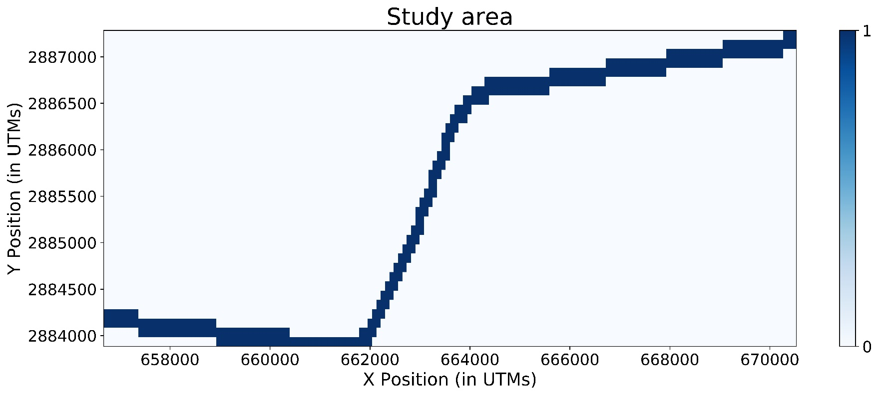
Methods
Within study area, number of mortalities known
Function to replace NA values in study area with zero
Notes:
Because we are conducting linear survey transects, we know how many mortalities occurred in each location
Therefore any location within the transect that has no mortalities should have a value of 0 not NA
Python allows for the creation of a function that will replace all NA values within a survey transect with 0
Python figure that shows the study area

Slide 5
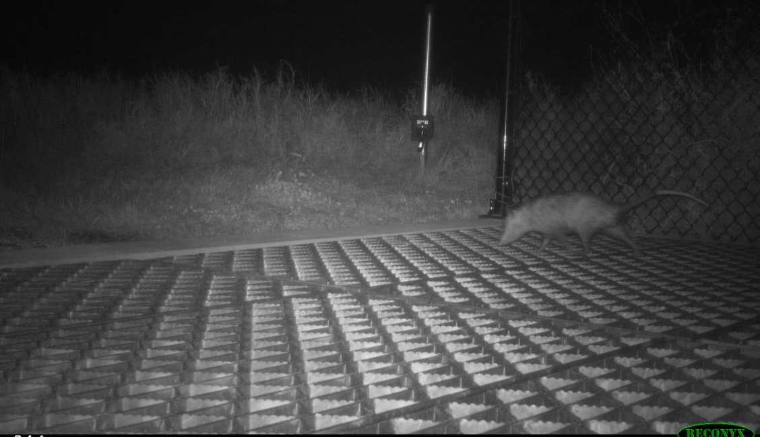
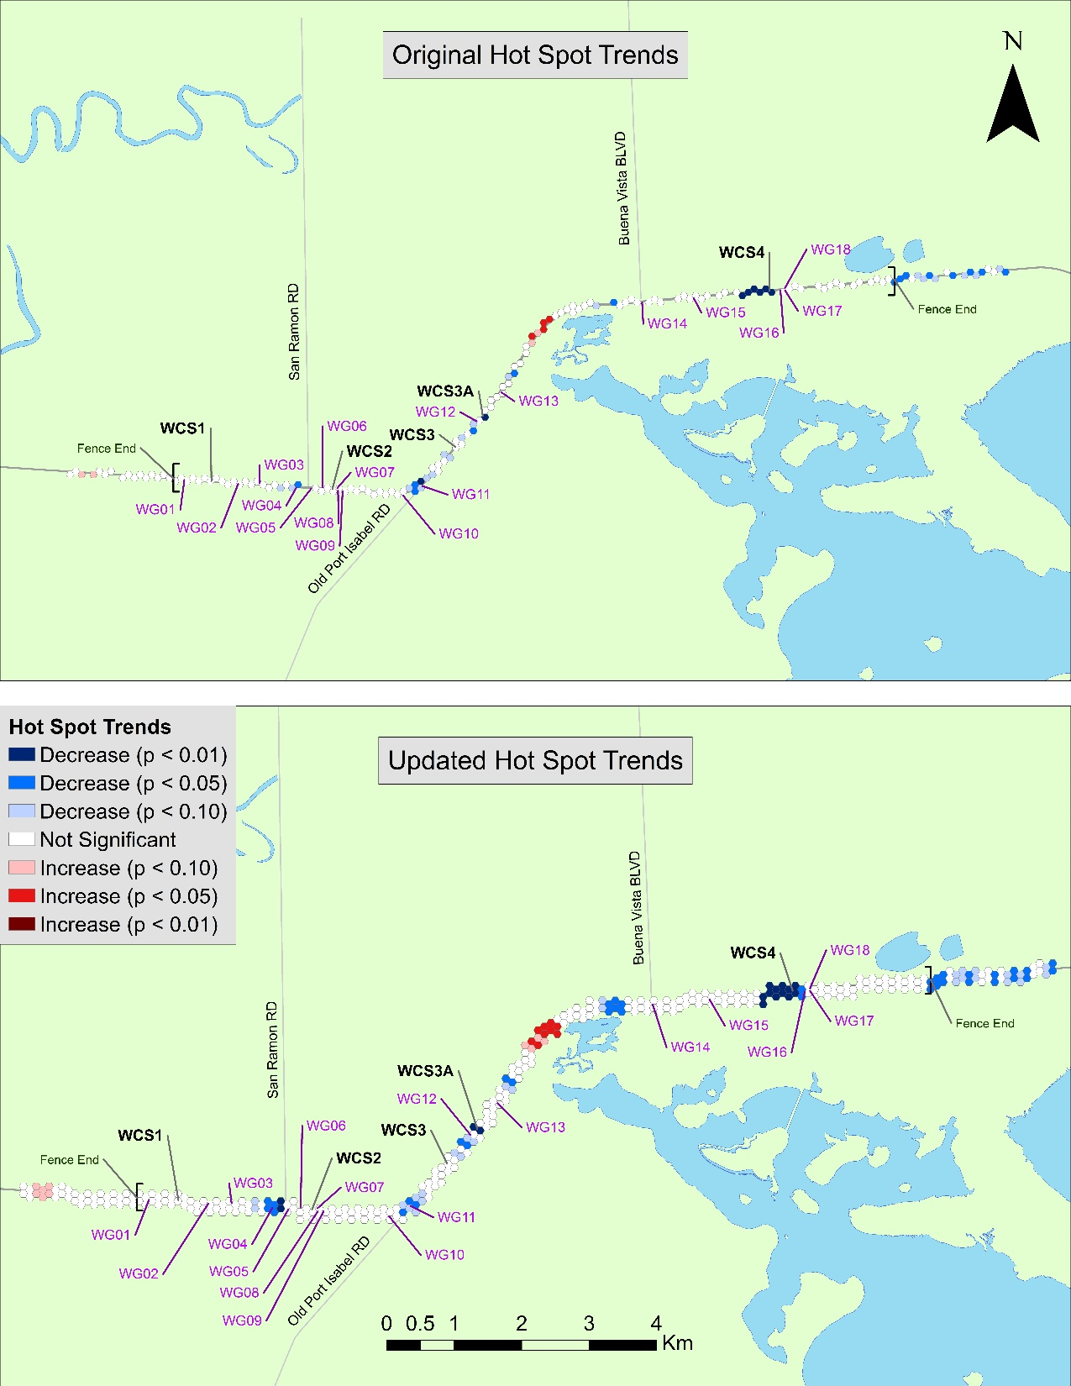
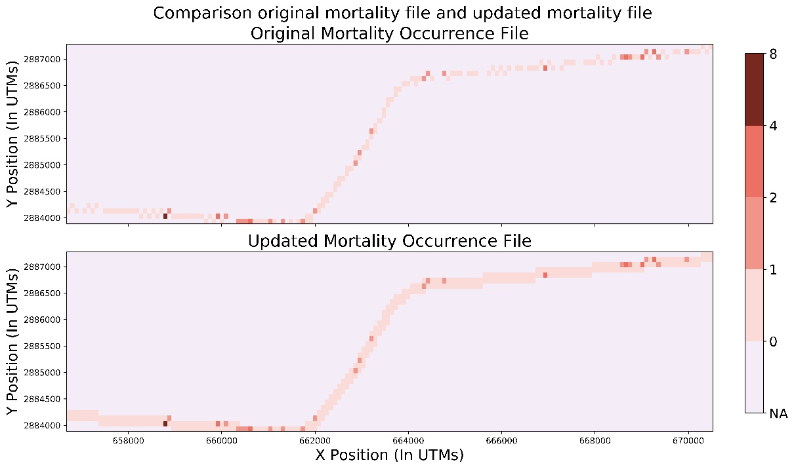
Results
Function replaces NAs with zeros in study area
Emerging Hot Spot Analysis has different results
Notes:
Made a function using Python packages Fiona and NetCDF4 that will do this
Bottom figure shows the difference between

Slide 6
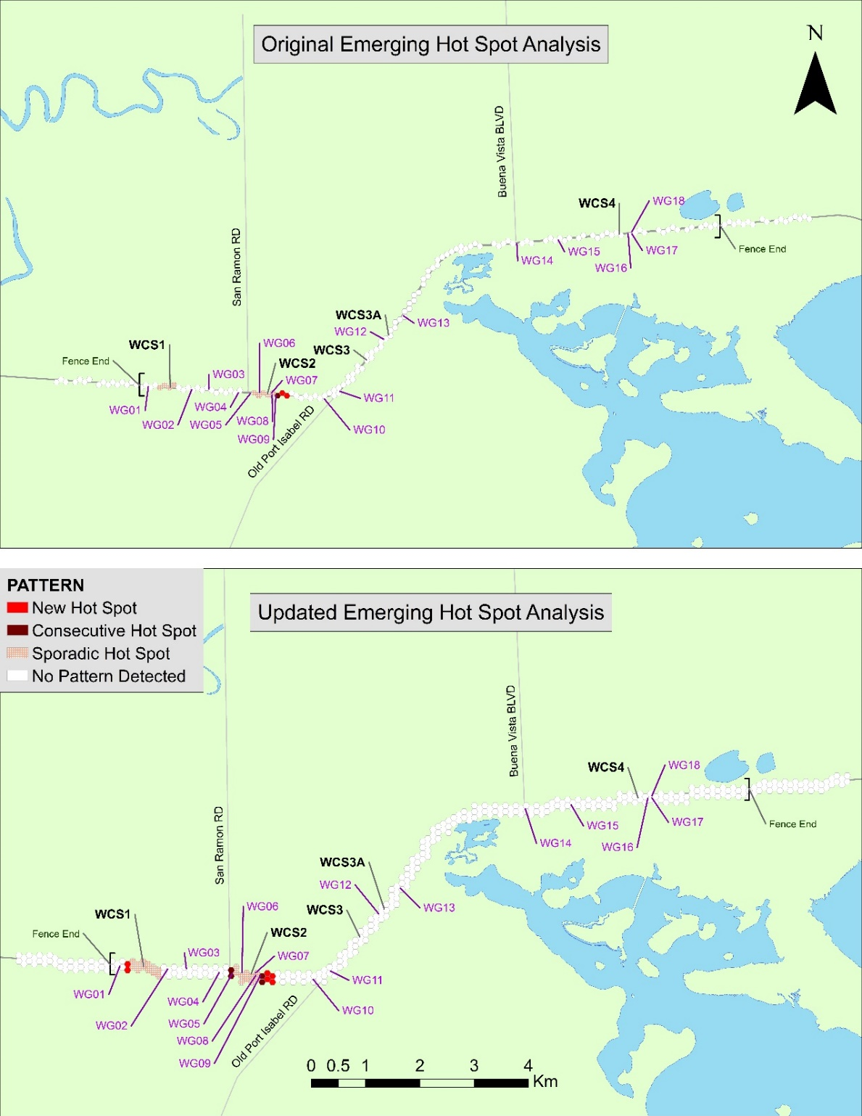
Discussion
Important to account for non-missing data in spatial analysis
ArcGIS and Python not as compatible as you’d think
Notes:
Spatial statistics are finicky about spatial relationships so if you can fill NA values, it is important that you do so
Even though ArcGIS is a Python based program, it uses an older Python architecture (32 bit Python 2.7) so is not easily compatible with a lot of Python modules

Slide 7
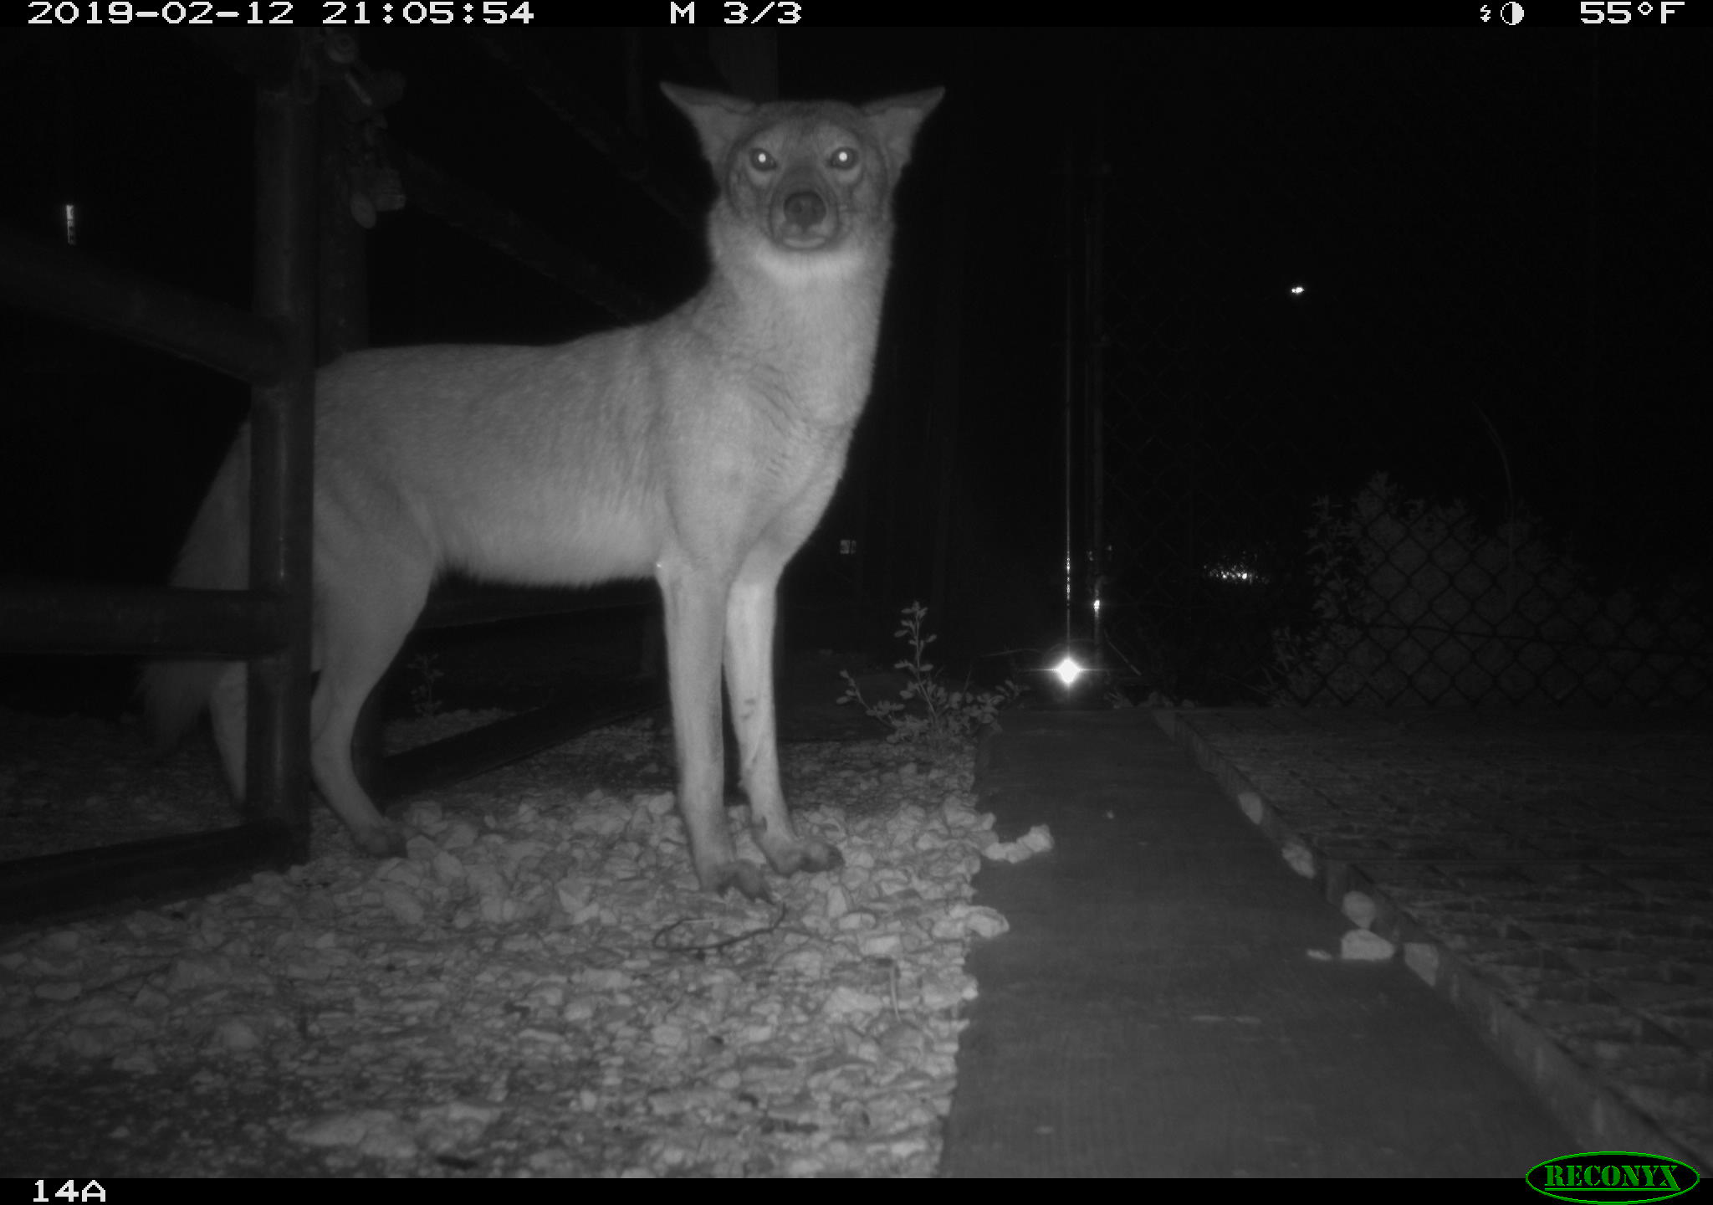
Questions?
Notes:
Questions or comments?
This is going to be a part of my thesis so anything is appreciated

Slide 8
Questions?

